Slide 1
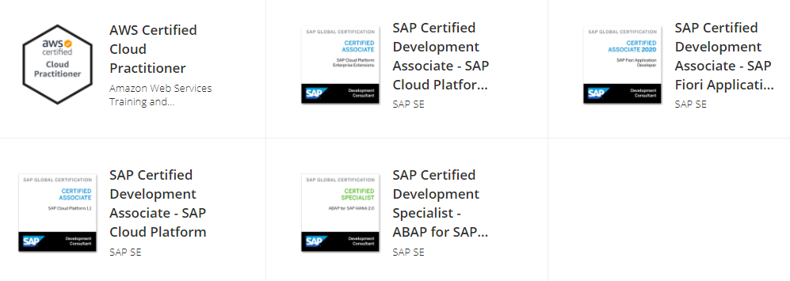
“My SAP Certification’s Journey”
Relevancy in current scenario
Mohit Bansal, Singapore ,March 20, 2021
SAP S/4HANA Technical Lead Developer | Fiori Consultant | Solution/Technical Architect
SAP Stammtisch India

Slide 2
Agenda
My SAP Certification’s Journey Overview
Registration & Choice of Certifications & Claim the Certification
How I Prepare for the certification / Learn new Technology
Key Certifications Deep Dive : ABAP ON HANA, Fiori and Cloud Enterprise Extensions
Key take away & Lesson Learned
Questions & Answers

Slide 3
Disclaimer
This is not SAP approved not endorsed presentation.
This is the information based on my experience , insights and current information( and somewhat educated opinion) on the current and future state of the SAP offering.
Certification cost / price is for indicative purpose, please check SAP’s official website before purchasing any certifications.
Certification topic and weightage is indicative purpose only, Please check SAP’s website for the certification topics and weightage for individual topics.
Readers are cautioned not to place undue reliance on these forward-looking statements, they should not be relied upon in making purchasing decisions.
The Global Leader in Commercial Explosives and Blasting Systems

Slide 4
My Certification’s Journey Overview
ABAP ON HANA E_HANAAW_16
Fiori Developer C_FIORIDEV_21
SAP Cloud Platform – Enterprise Extensions C_CPE_12
SAP Cloud Platform C_CP_11
AWS- Cloud Practitioner
CLF_C01
4xSAP Certifications
1xAWS Certification( IaaS)
Transition from Developer to Architect
ABAP Developer
Developer
Lead Developer
SAP Technical Architect
Solution Architect

Slide 5
Registration & Choice of Certifications & Claim the Certification
Register at SAP’s Training Website for SAP Global Certification online Exam (CER006).
CER006 is most Cost effective | $599 USD | 44,366.00 INR ( Tax excluded)*
Subscription is valid for 1 year | 6 Certifications | 3 attempts each
Flexibility to Choose 6 Certification | Online Protector Exam | Schedule & Go
Claim your Certificate from Your Claim | Training Dash Board
The Global Leader in Commercial Explosives and Blasting Systems

Slide 6
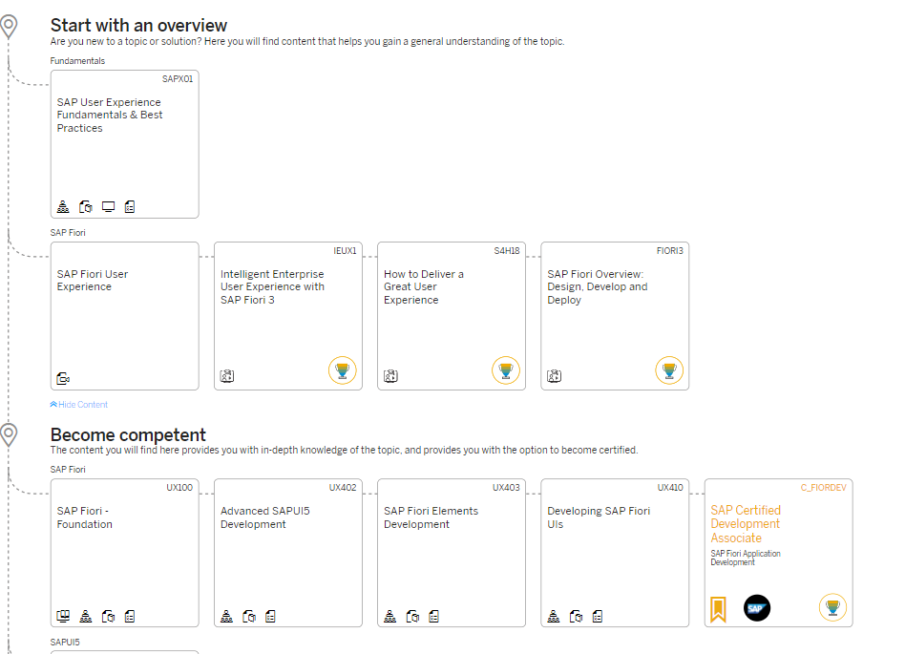
How I Prepare for the certification / Learn new Technology
SAP provided Learning Journey
Real time exposure on Individual Projects
Client’s Demo / Competency Building POC’s
SAP Learning Hub Subscriptions / SAP Press Books
OPEN SAP Courses, Learn directly from experts
Developer.sap.com having wonderful hands tutorials
SAP Community / SDN / Blogs / Youtube Videos
Example
The Global Leader in Commercial Explosives and Blasting Systems

Slide 7
Key Certifications Deep Dive : ABAP ON HANA
Specialist Level Certification, Preparation duration around 3-4 months.
Please read as many as times HA400 and practice all important concepts.
Mostly concentrate on CDS / AMDP / Table Functions / Performance Optimizations / Open SQL
Recommended Open SAP ABAP ON HANA course.
Few topics like ADBC / Procedure Proxy / external views touch based before exam.
Information modelling/ Calculation Views very few questions will be asked.

Slide 8
Key Certifications Deep Dive : Fiori Application Developer
Preparation duration around 2 to 3 months.
Please read as many as times UX402 & UX410 and practice all important concepts.
SAP Press Fiori Certification guide and Open SAP UI5/ Fiori Course guide is highly recommended
Mostly Questions will be conceptual based on
MVC Architecture / XML Views
Data Bindings ( OData / JSON ), i181n Model
Usages of manifest. Son , component controller & neoapp.json
Understanding of Fiori Elements and Usages of annotations are very important.

Slide 9
Key Certifications Deep Dive : SAP Cloud Platform Enterprise Extensions
Please read as many as times CLD200 & CP100 and practice all important concepts.
It is mostly relevant for S4HANA on Cloud.
In App extensibility is common for S4HANA on premise and S4HANA On Cloud.
Recommended blog for https://blogs.sap.com/2020/12/20/get-certified-c_cpe_12/
Demo S4HANA Cloud can be taken from amazon for practice.

Slide 10
Key Lesson Learned / Benefits from Certifications
“An Investment in the KNOWLEDGE always pays the best Interest”- Ben Franklin
Learning is a continuous process, all the learning must be supported by the evidence from the third party, hence, Certifications are must.
Keep the same enthusiasm until we pass the Certification.
Read religiously your SAP Certification Books and Practice in system as many times as possible.
Read Key Concepts First and Fundamentals should be strong.
Certifications certainly adds value in Professional career at various level.
Few People will call ‘Certification is waste of money’. Ignore them. Be Positive, Think Positive and Stay Positive.

Slide 11
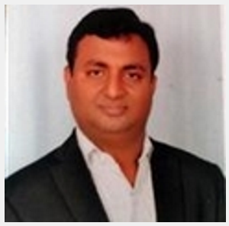
Thank you
Contact details
Mohit Bansal
Email – mohithmbansal@gmail.com
Mobile Number + 65-91573959
LinkedIn :
https://www.linkedin.com/in/mohit-bansal-430a8218/
SDN Blogs: https://people.sap.com/mohit.bansal3#content

